Slide 1
Executive MBA Program
Riyadh Track
April 2026
In Collaboration with

Slide 2

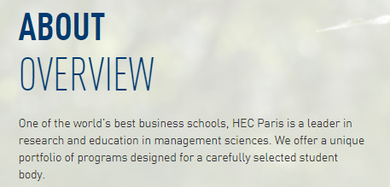
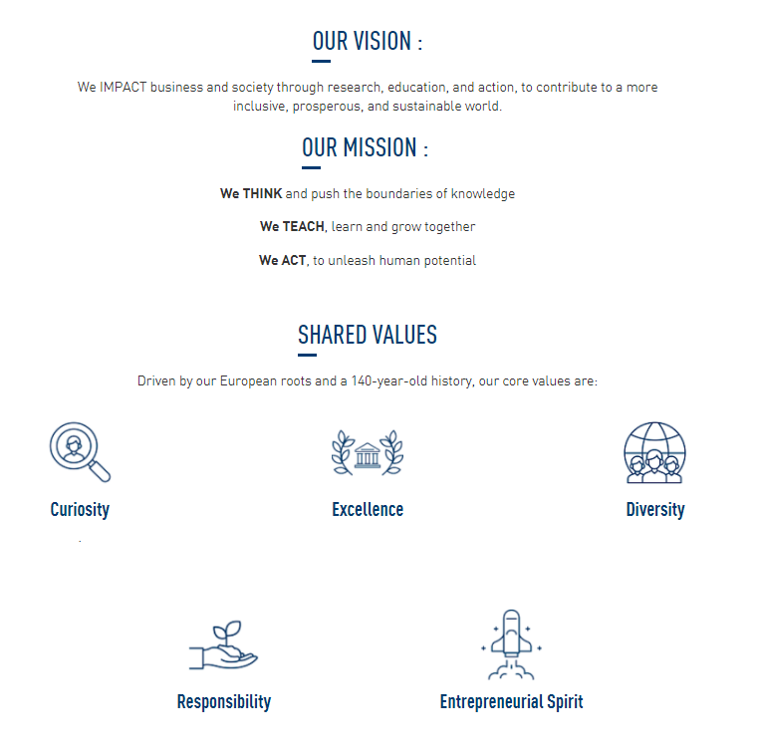
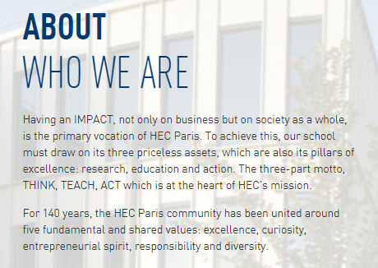
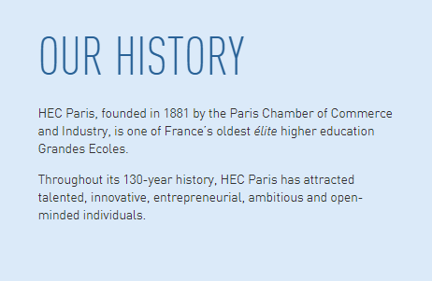
TOMORROW IS OUR BUSINESS
HEC Paris, founded in 1881 by the Paris Chamber of Commerce and Industry, is one of France’s oldest elite higher education Grandes Ecoles.
Throughout its 140-year history, HEC Paris has attracted talented, innovative, entrepreneurial, ambitious and open-minded individuals.

Slide 3






A BUSINESS SCHOOL
WITH AN INTERNATIONAL RECOGNITION
HEC Paris works with and provides lifelong support to tomorrow’s decision-makers,
leaders, and senior executives worldwide.
#2
#2
#2
Worldwide
Executive Education
European
Business School
Worldwide
Executive MBA

Slide 4




AlTamayyuz Academy collaboration
Devoted to developing the talent that will
drive growth, innovation and transformation
Experienced partnerships in talent development
Invests in building potential and
current leaders across the Kingdom
Committed to bringing thought leadership
to the Kingdom and to the ecosystem

Slide 5
HEC PARIS
Executive MBA Program

Slide 6
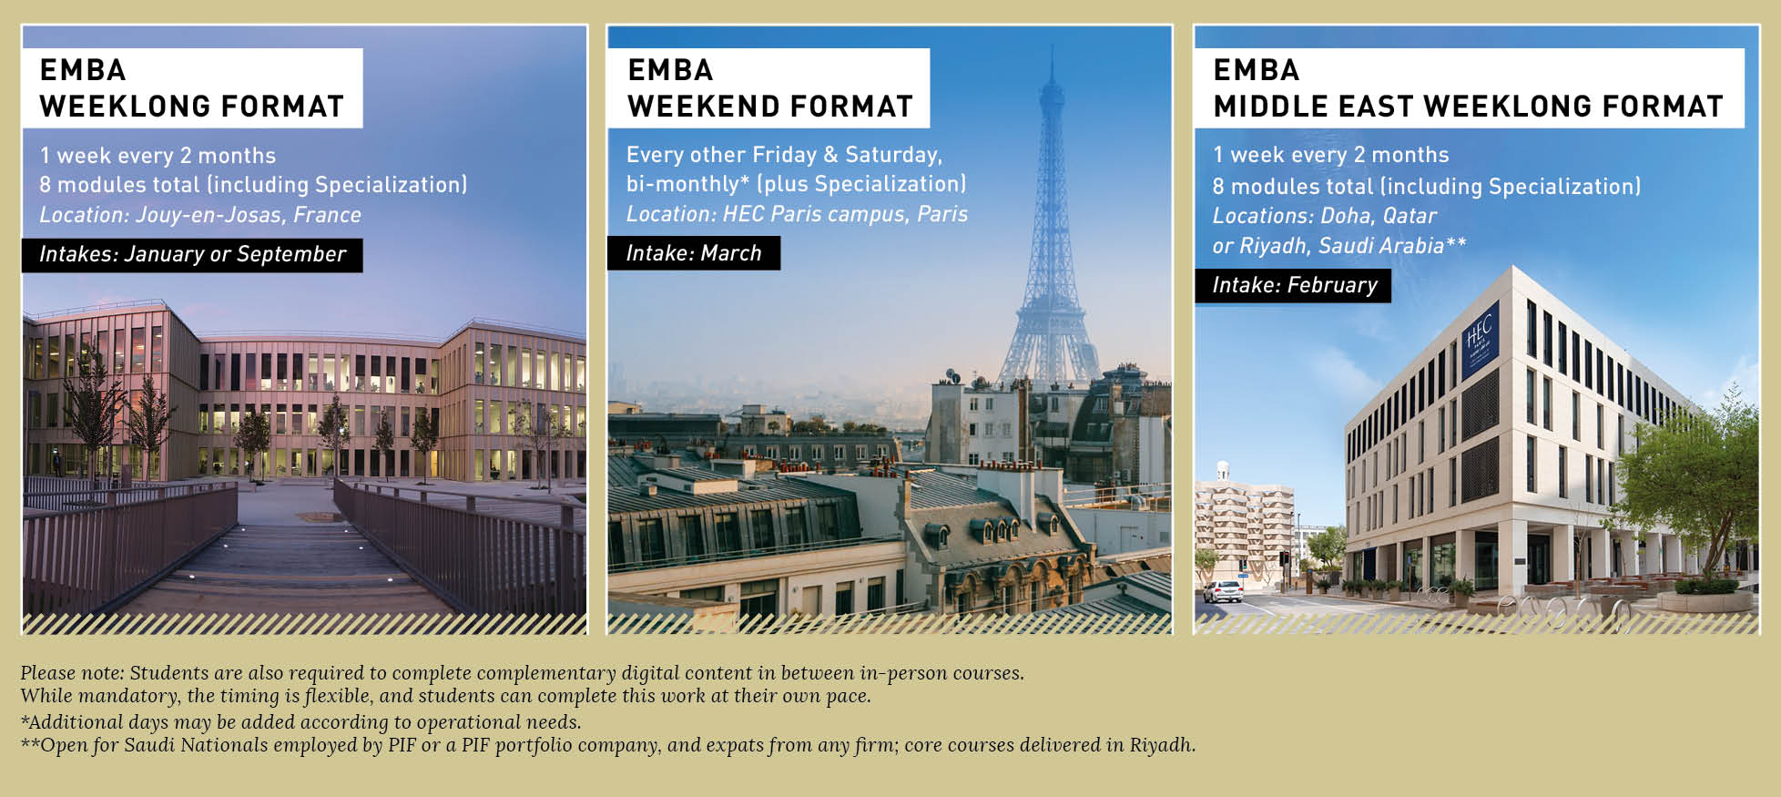
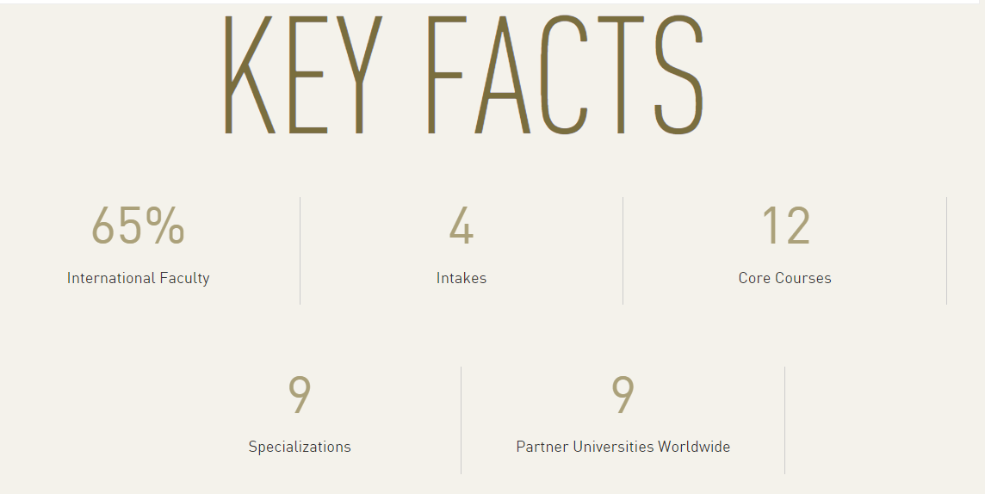
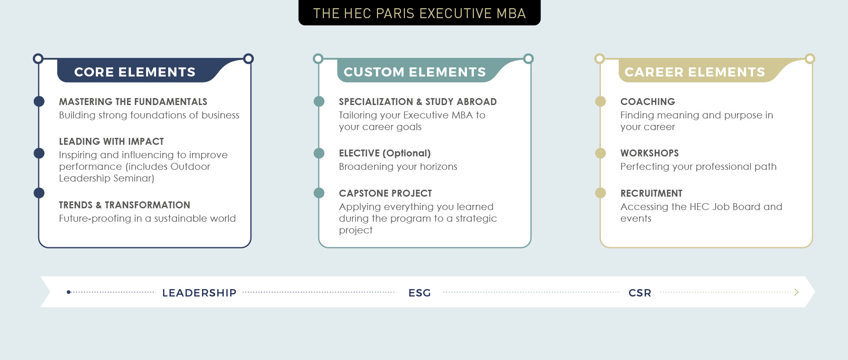

HEC Paris EMBA Program

Slide 7
EMBA ADMISSIONS overview
Pre-requisites
Admission Process
Alumni Network
Bachelor’s Degree (or equivalent) from a recognized university*
Minimum of eight years of professional experience
  (of which) minimum of 5 years of managerial experience
English Language Proficiency
(TOEIC, TOEFL or IELTS min. score of 6.5, taken no more than two years ago) if the Bachelor’s Degree was not taken in English or the candidate's mother tongue is not English
* Candidates with minimum of secondary education may also considered if they have sufficient managerial experience.
Preliminary information interview
Interview with a Program Advisor
on the eligibility for the program
Online application form including
• Personal essays + CV
• Two references
• Bachelor’s Degree evidence
Selection Process
HEC Paris general management test
(or GMAT exam taken no more than three years ago)
Selection Committee panel interview
(comprised of professors, alumni, executive directors from HEC Paris)
Final Jury
Final review and decision
All EMBA participants may join the HEC Paris alumni community, with its 80,000 members. Recognized as one of the most influential associations
globally, HEC Paris alumni access a worldwide network of peers and are entitled to:
Join the Association of HEC Paris graduates and take part in the many activities available globally.
Become a member of the HEC Paris Executive Education alumni network on the international professional social networks.
These exchanges extend the HEC
Paris experience, expand graduates’
professional network and strengthen
their link with HEC Paris as an institution

Slide 8
emba program timeline
Virtually-enabled Coursework
Core Courses
EMBA PROGRAM
LAUNCH
Executive Leadership Booster
Leading With Impact
PROGRAM CERTIFICATION
Specialization
21 April 2026
Capstone
Program completion time: 16-18 months
52 days of face-to-face learning
  including 16+ hours of Personal and Professional Development (PPD)
150+ hours of virtual learning
Access to GNAM elective courses(Global Network Courses): https://globalnetwork.io/members
Each module 5-10 days, generally 9:00 am to 6:00 pm
Guest speakers
Networking events, evening sessions, social activities
Leadership and career coaching
Individual Capstone advising

Slide 9
Emba program architecture
Indicative only. Actual curriculum may vary.
Core Courses All modules mandatory Riyadh | Specializations Choose one of nine Location varies | Leading with Impact Riyadh + Paris | Capstone Practical Application Riyadh + Self-paced
Module 1 Fundamentals of Leadership Business Environment | Making Artificial Intelligence Real Innovate like an Entrepreneur Leading a Sustainable Energy Transition Luxury, Today and Tomorrow Board Governance Driving Excellence in Healthcare Making the Right Financial Decision Reimagining Service Excellence for a Tech-Driven World Scaling for Success | Leadership Outdoor Seminar and Executive Leadership Booster Personal & Professional Development workshops (PPD) Topics in General Management (TGM) | Strategic analysis of an existing company or new business venture, conducted in a team or individually. The final deliverable of the Executive MBA, it enables participants to apply their learning and focus on a strategic issue with real added value for their organization or themself.
Module 2 Ethics & Social Responsibility Business Strategy Financial Accounting
Module 3 Corporate Finance Marketing Strategy
Module 4 Digital Management Corporate Strategy Negotiation
Module 5 Entrepreneurial Mindset Operations Management
Module 6 Business Performance Management Leadership in Action Orchestrating Transformation

Slide 10
emba learning journey
Personal and Professional Transformation
Case Studies
Peer Learning
Thought Leadership
Simulations
Guided Pedagogy
Group Projects
Personal Development
Experiential Learning
Self-paced Learning
Applied Learning
HEC Paris employes a holistic learning approach.
A wide variety of pedagogic tools and learning methodology is employed throughout the learning journey, increasing learner engagement, skill acquisition and positive mindset shift.

Slide 11


HEC Paris ALUMNI
ONE ASSOCIATION TO BRING TOGETHER ALL HEC Paris GRADUATES
Graduates from the Riyadh track become alumni of HEC Paris, with full rights and access to all platforms and services provided by the Association, including lifelong learning opportunities.
HEC Paris will provide a free, life-time membership to alumni from the Riyadh track.
A local alumni chapter is already established in Riyadh.
80,000

